Slide 1
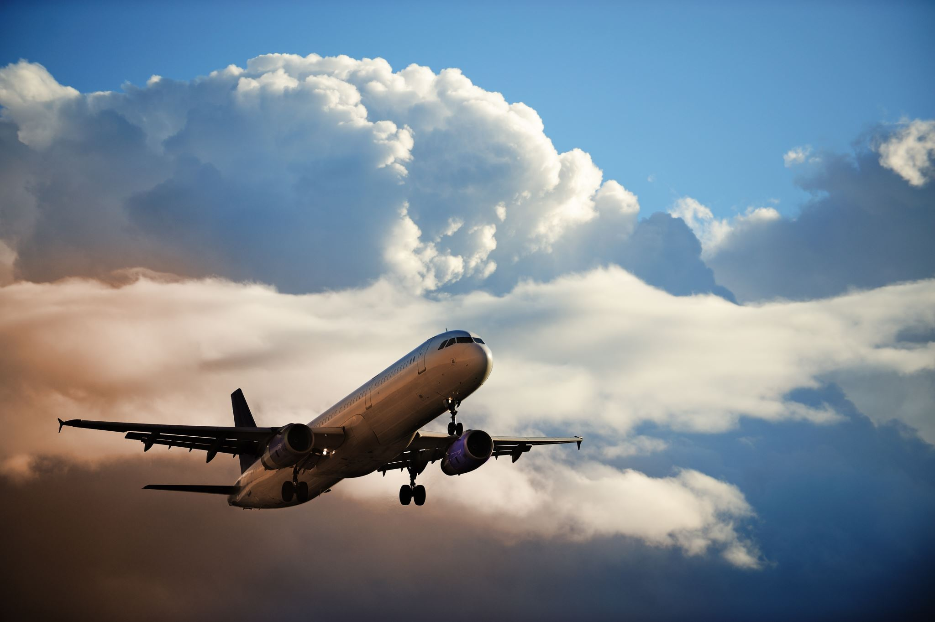

T4Y2F Airlines Presentation
Trish Girmus
November 20, 2021

Slide 2
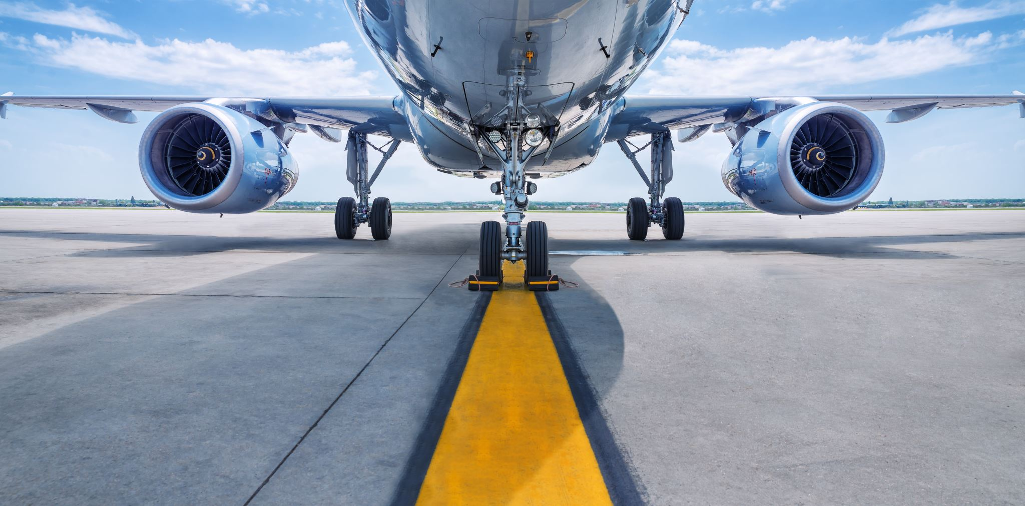

AIR TRAVEL IS SAFEST MODE OF TRANSPORTATION
OVERVIEW
Data collected and analyzed over 34-year time span ranging 1985-2019:
Airline Data
Motor Vehicle Data
Bus Data
Railroad Data
Boat Data
Bicycle Data

Slide 3
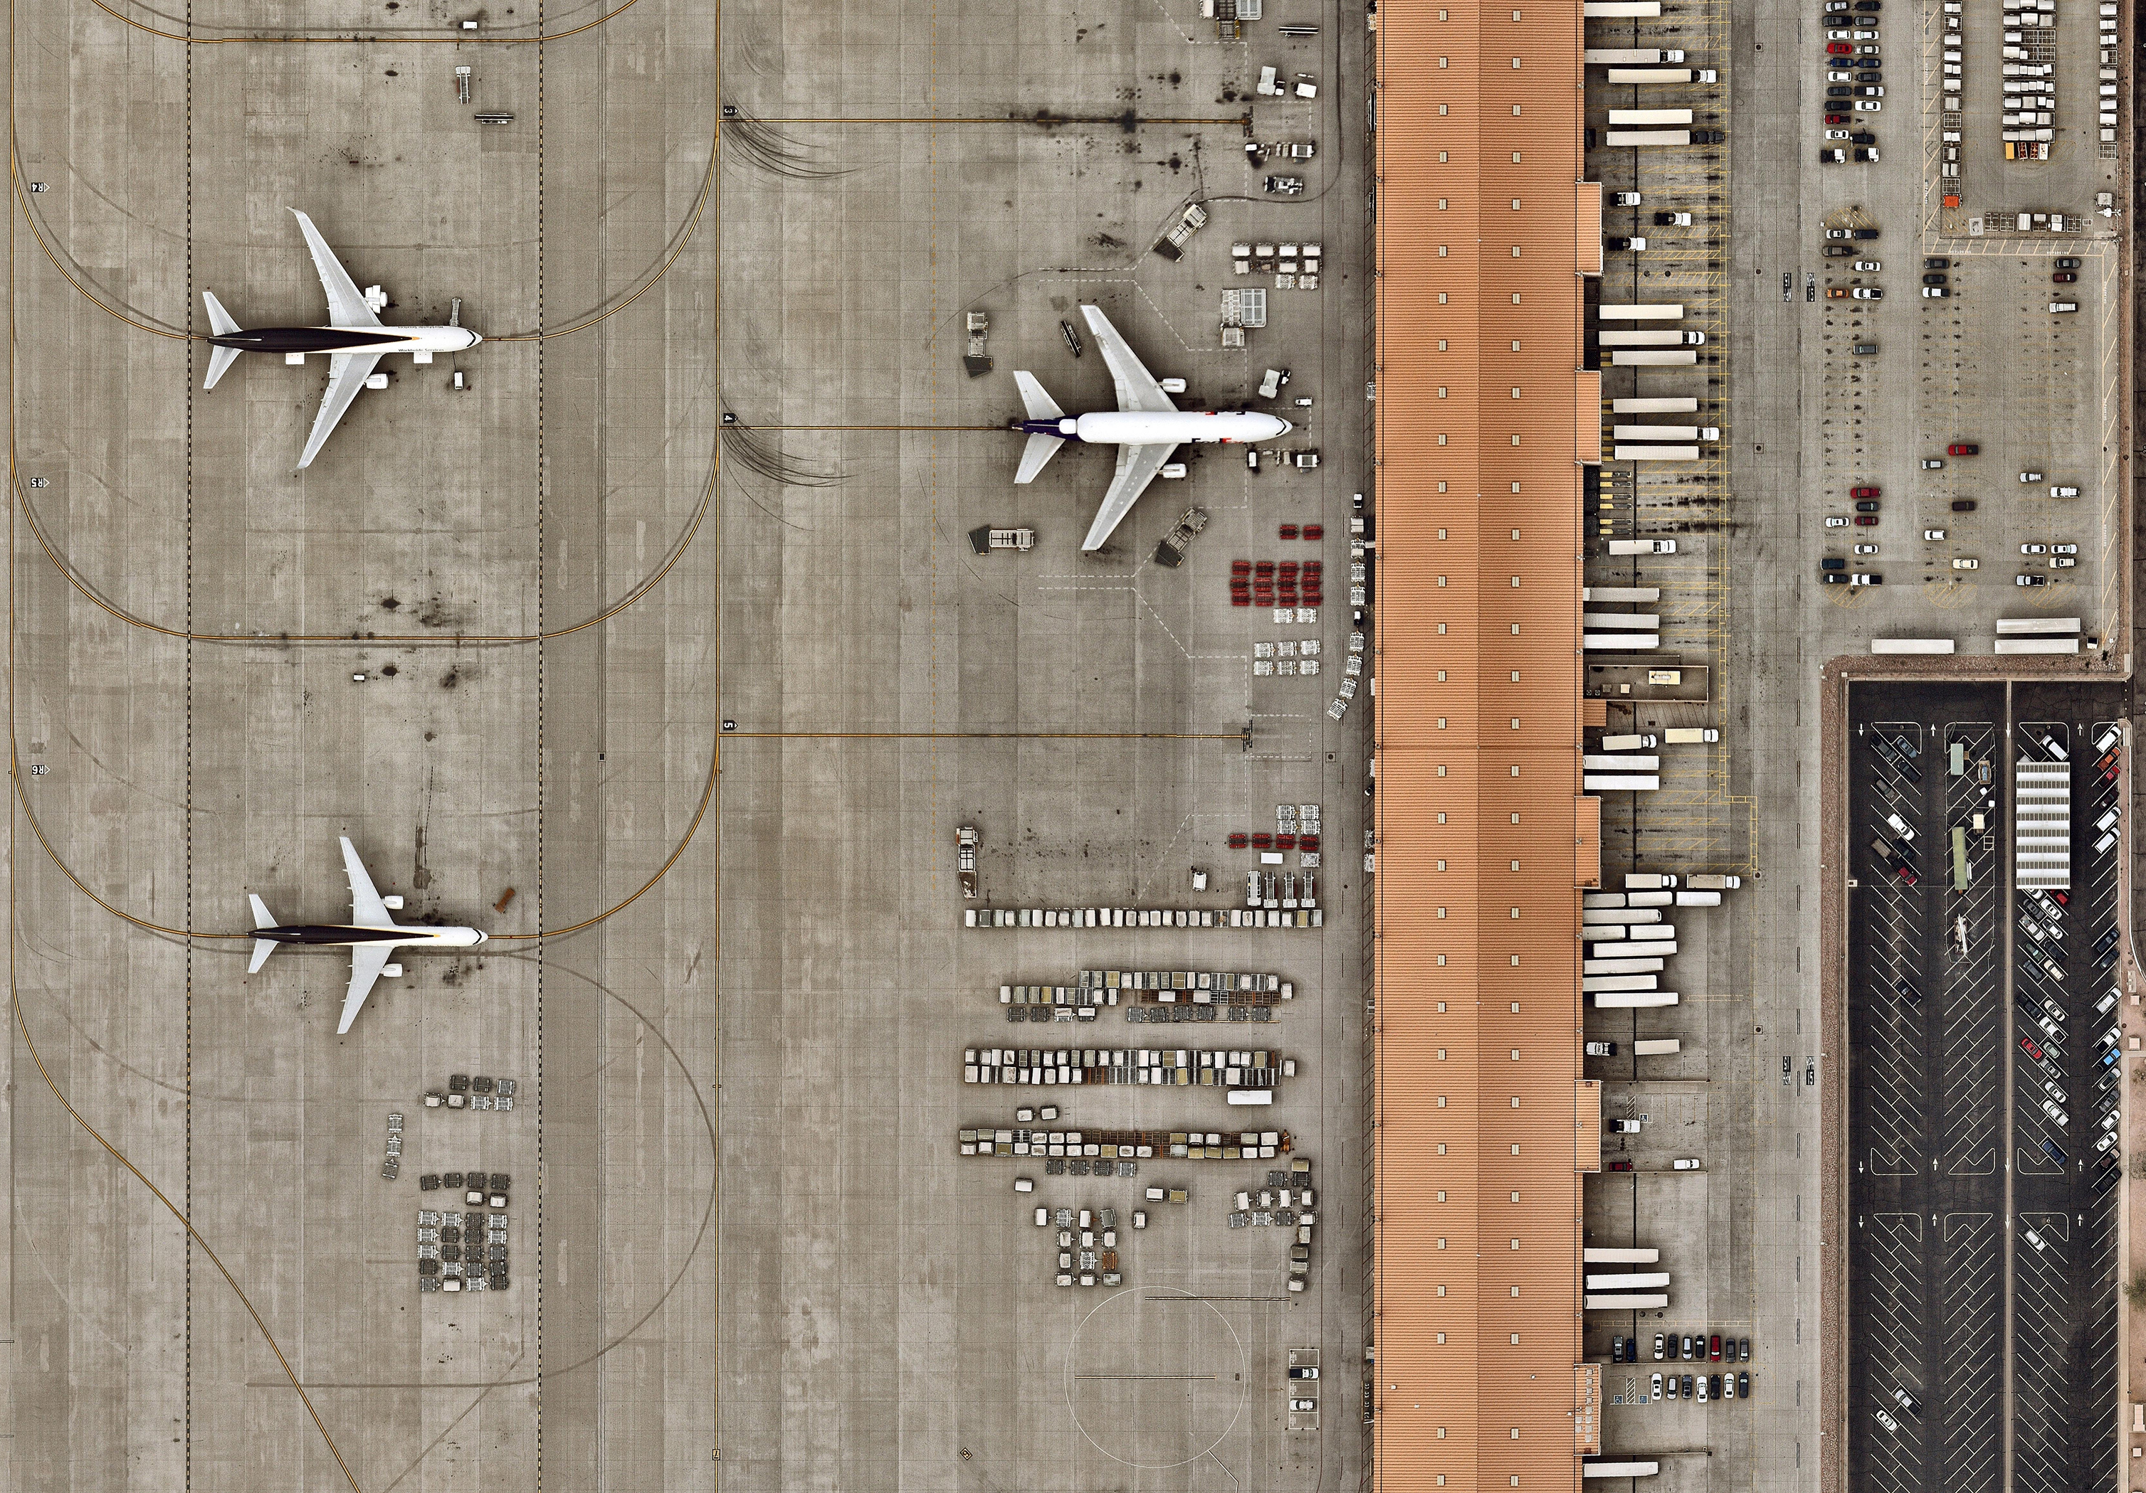
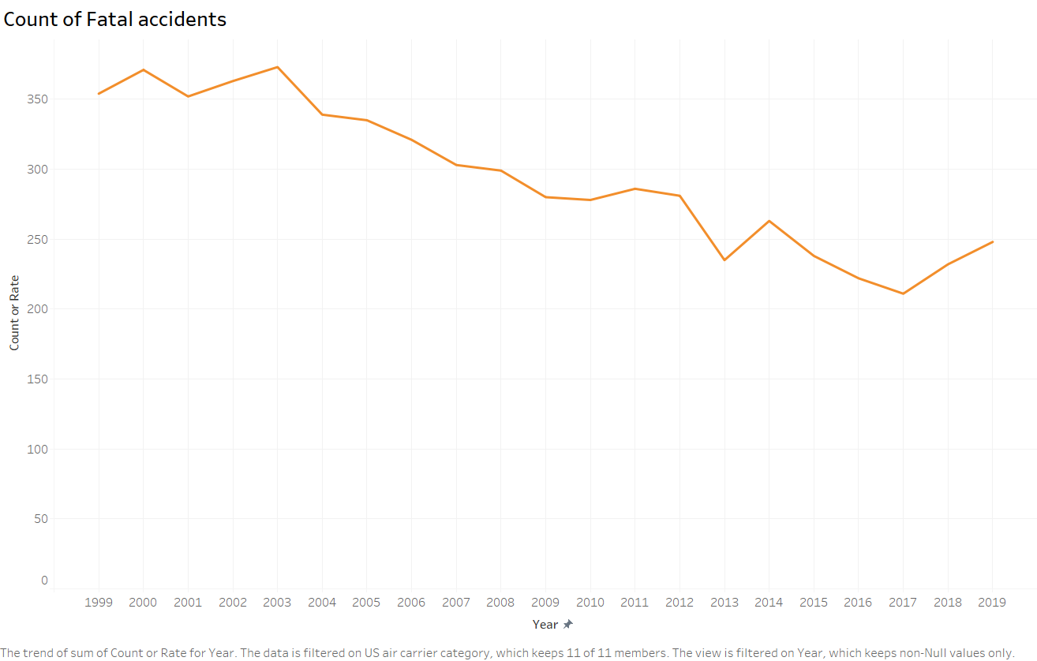

1999-2019 Airline Fatal Accidents Totals
354
(1999)
248
(2019)

Slide 4
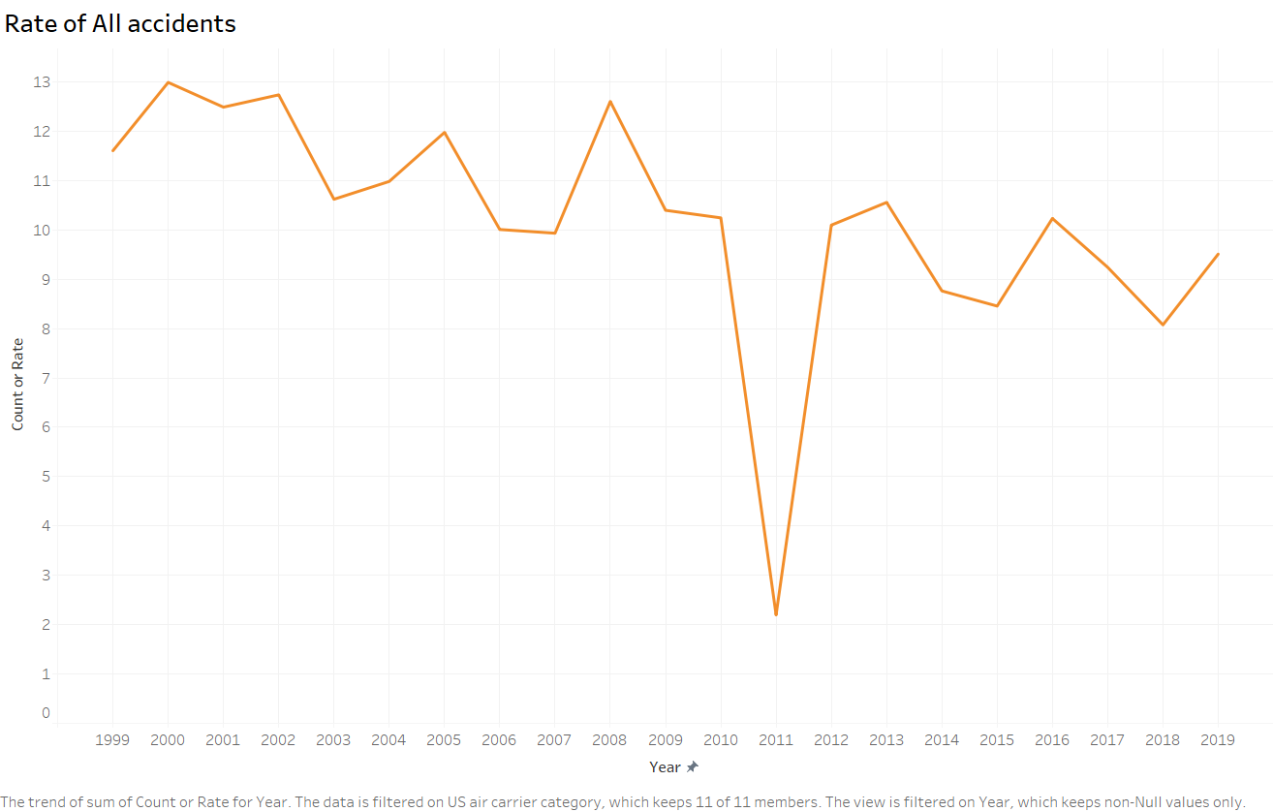

1999-2019 Airline Rate of All Accidents
11.61
(1999)
9.51
(2019)

Slide 5
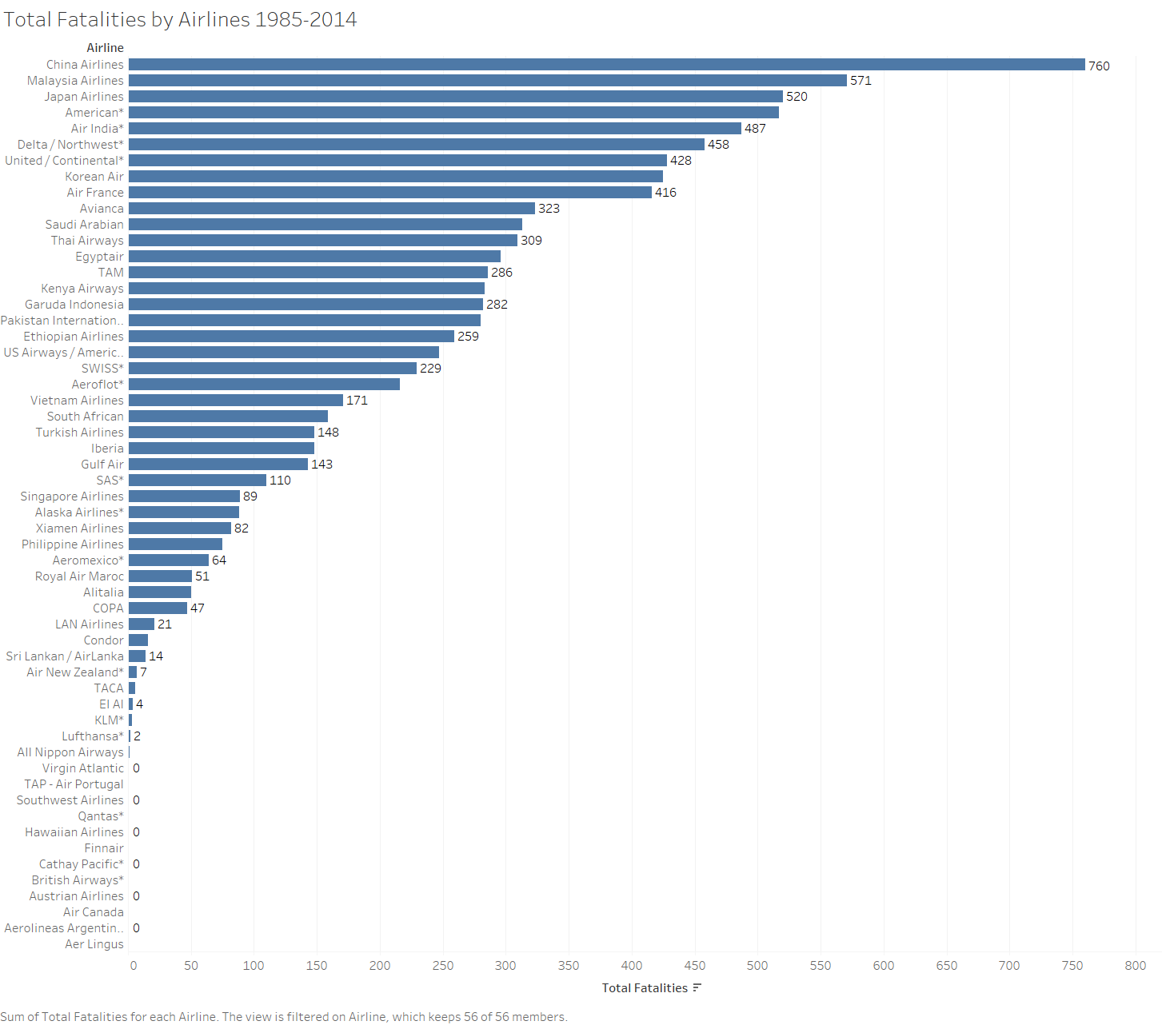
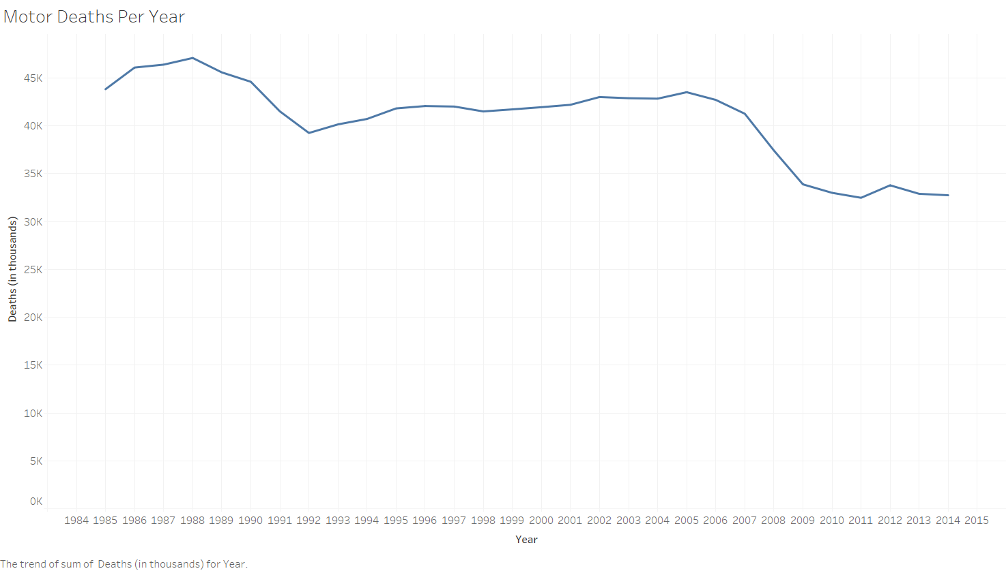


1985-2014 Airline & Motor Vehicle Fatalities
9,404 airline fatalities total
(1985-2014)
43,825
(1985)
32,744
(2014)

Slide 6
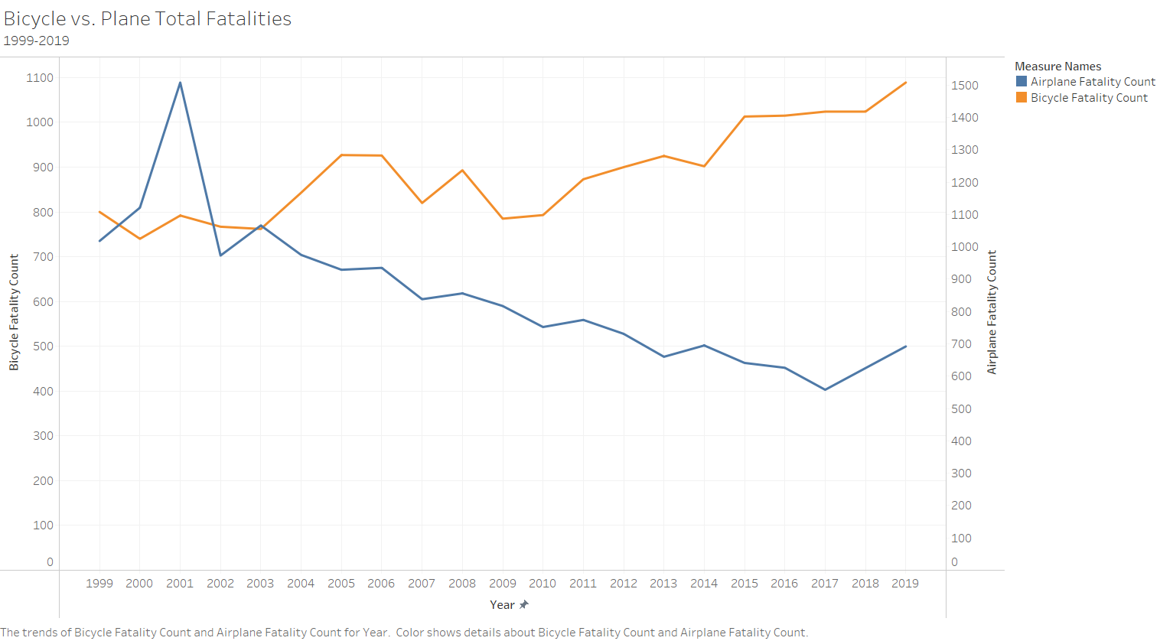

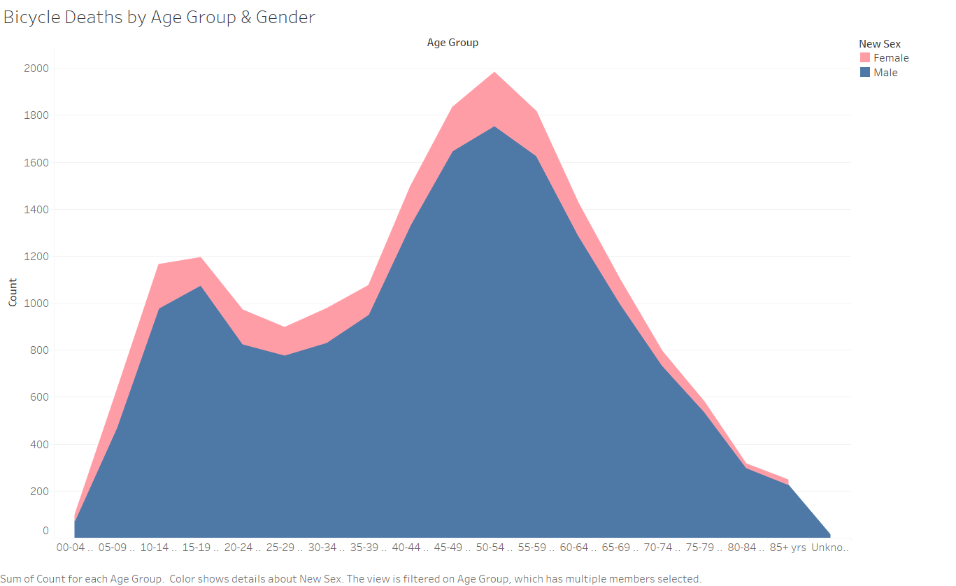

1999-2019 Bicycle & Airplane Fatalities

Slide 7
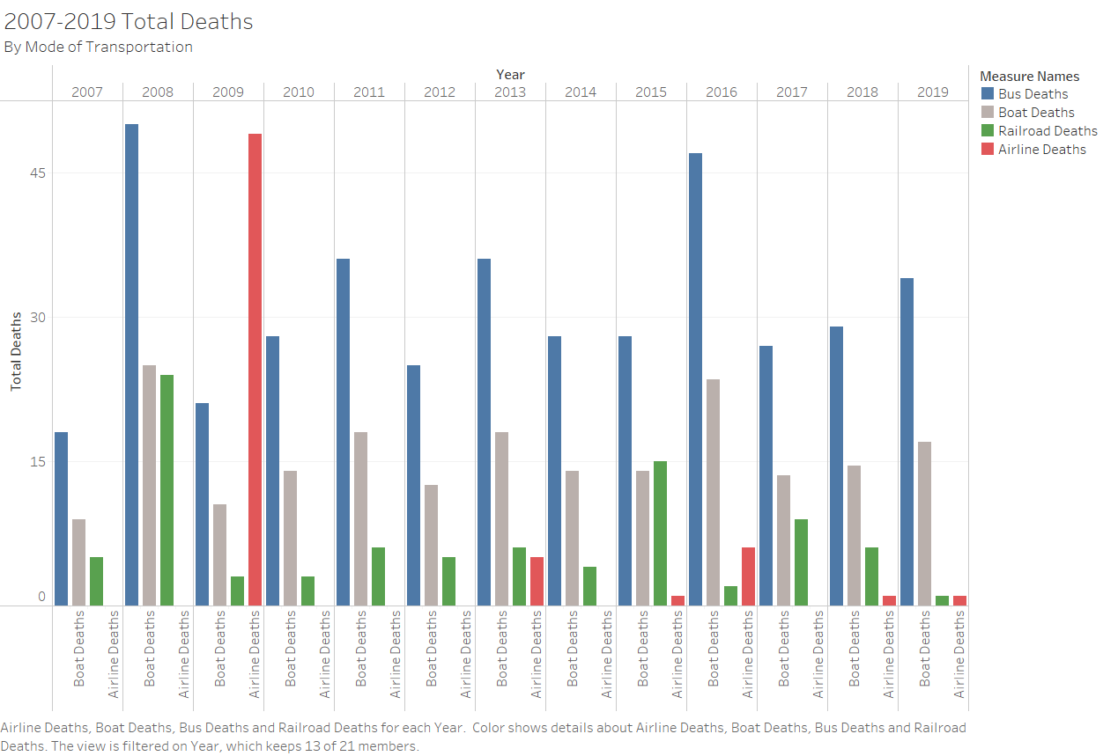


2007-2019 Bus, Boat, Railroad & Airline & Vehicle Deaths

Slide 8


Conclusion
The data proves that airline travel is much safer than all other modes of transportation
Pack your bags - adventure awaits!
It’s Time for You to Fly!

Slide 9

Sources
Airplane crashes. Injury Facts. (2021, April 21). Retrieved from https://injuryfacts.nsc.org/home-and-community/safety-topics/airplane-crashes/.
Bicycle deaths. Injury Facts. (2021, April 21). Retrieved from https://injuryfacts.nsc.org/home-and-community/safety-topics/bicycle-deaths/.
Boat deaths. Source generated by author.
Deaths by transportation mode. Injury Facts. (2021, April 15). Retrieved from https://injuryfacts.nsc.org/home-and-community/safety-topics/deaths-by-transportation-mode/.
Fatality facts 2019: Yearly snapshot, Motor vehicle crash deaths per 100 million miles traveled, 1975-2019. IIHS. (n.d.). Retrieved from https://www.iihs.org/topics/fatality-statistics/detail/yearly-snapshot.
https://github.com/fivethirtyeight/data/tree/master/airline-safety. (2014, July 23). Airline Safety. https://github.com/fivethirtyeight/data/tree/master/airline-safety.
Silver, N. (2014, July 19). Should travelers avoid flying airlines that have had crashes in the past? FiveThirtyEight. Retrieved from https://fivethirtyeight.com/features/should-travelers-avoid-flying-airlines-that-have-had-crashes-in-the-past/.

